Slide 1
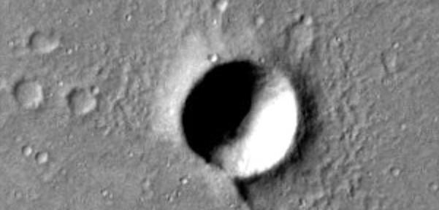

Exponential distribution
Not all things are Normal!
Craters of Mars
Air traffic delays

Slide 2

Craters of Mars:
An exponential distribution special

Slide 3


The Red Planet
…has captured our imagination from early on. Ancient Greeks and Romans related it to Mars, the belligerent God so anxious to go to war, he was…
Red In The Face!

Slide 4

Little Green Martians
In the 19th and 20th Centuries, many people believed Mars was inhabited by little green creatures who were ready to invade Earth without notice!

Slide 5
NASA’s Mars Missions
In 2001, Odyssey orbiter arrived to Mars on a mapping mission.
In 2003, NASA sent two Rovers to investigate whether Mars has any life-supporting elements such as water, and explore its natural resources.

Slide 6

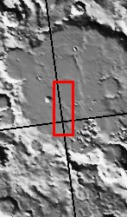
Mars 2001 Odyssey
The Mars 2001 Odyssey orbiter launched from Kennedy Space Center on 7 April 2001. The orbiter arrived at Mars on 24 October 2001. Upon arrival, the orbiter went into an ~18-hour capture orbit. The orbiter spent the next several months achieving a circular mapping orbit by aerobraking (using the atmosphere to slow and shrink the orbit).
Mapping photos of the Central Gusev crater were released on January 14, 2004, by NASA, JLP, and ASU.

Slide 7
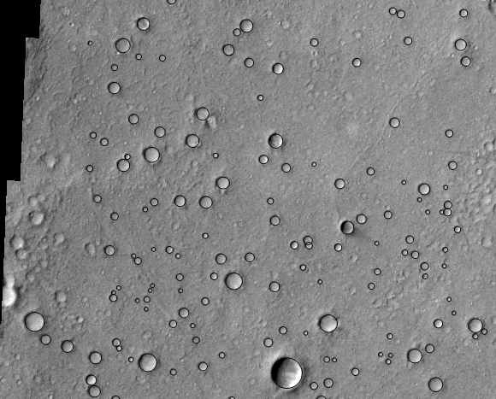
Sampling craters
Using Gusev’s mapping photo, the diameter of Martian craters could be established visually.

Slide 8
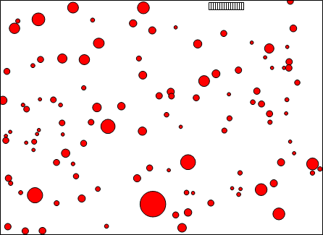
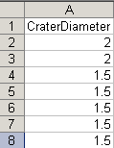
Data collection
111 crater diameters were measured and recorded

Slide 9
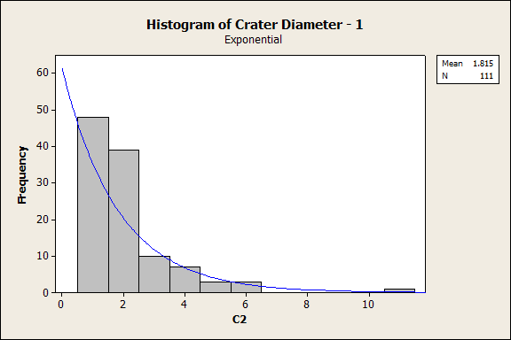
Distribution fitting
Using the statistical package MINITAB, an estimate of the exponential parameter λ was obtained.

Slide 10
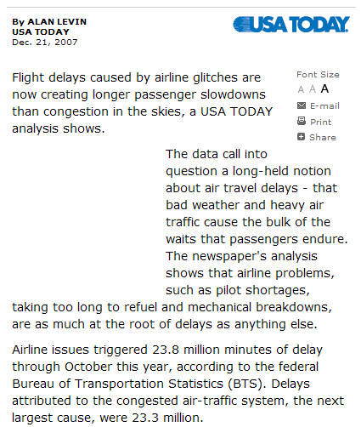
ON THE NEWS: Air traffic delays
Airlines love to blame it on the weather, but a new USA TODAY analysis shows the airlines’ own processes may be responsible
Pilot shortages, taking too long to refuel, and mechanical breakdowns, are now cited as main reasons. But bad weather can still cause a lot of trouble!

Slide 11
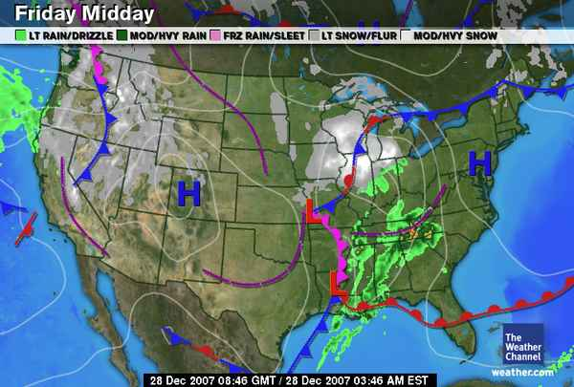
A case study: Atlanta airport delays, Dec 28, 2007
On Friday, December 28, 2007, a snow storm was developing in the Chicago area

Slide 12
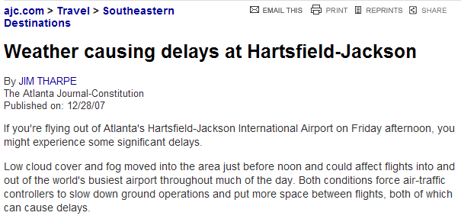
A case study: Atlanta airport delays, Dec 28, 2007
Meanwhile, weather condition in the Atlanta area were deteriorating
Flight delays at Atlanta’s Hartsfield-Jackson airport can impact air traffic all along the East Coast

Slide 13
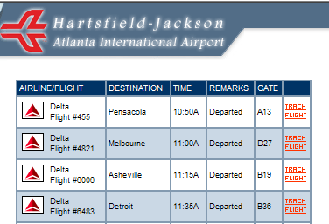
A case study: Data collection
As news stories started reporting flight delays, data on Delta flights departing from Hartsfield-Jackson airport (Atlanta) on Friday, December 28, 2007, were collected from the airport’s Web site (www.atlanta-airport.com)
Atlanta-based Delta is responsible for about 70-80 % of the Atlanta airport’s flights

Slide 14
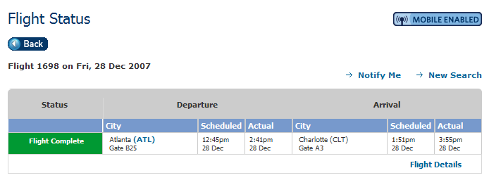
A case study: Data collection
Airport data were cross-checked with airline data obtained from Delta’s Web site (www.delta.com), to establish the actual departure times

Slide 15
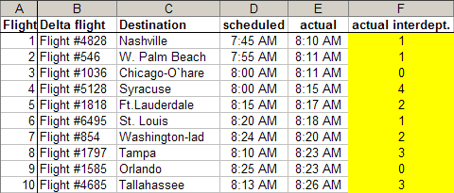
A case study: Data collection
Between 8:10 AM and 3:10PM on 12/28/2007, 397 Delta flights were scheduled to depart from Atlanta, but only 286 actually departed
30 flights were canceled and most others were delayed, typically by 2-3 hours
Actual departure times were ordered and first differences were calculated to obtain 285 inter-departure times

Slide 16
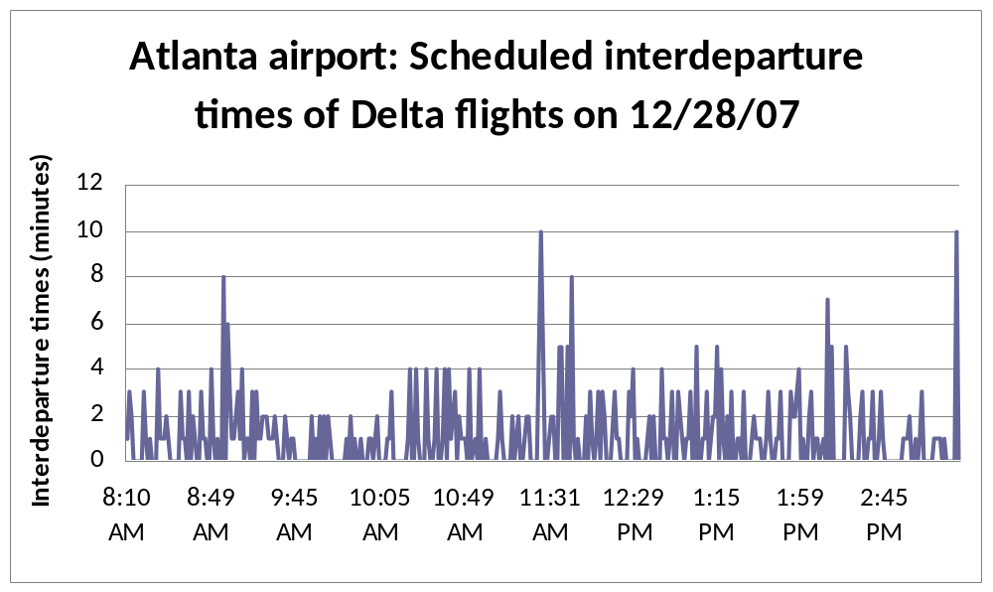
Data collection: Scheduled departures
This time series plot shows the 396 inter-departure times for the 397 Delta flights that were scheduled to fly out of Atlanta on 12/28/2007, in the 8:10 AM – 3:10 PM period

Slide 17
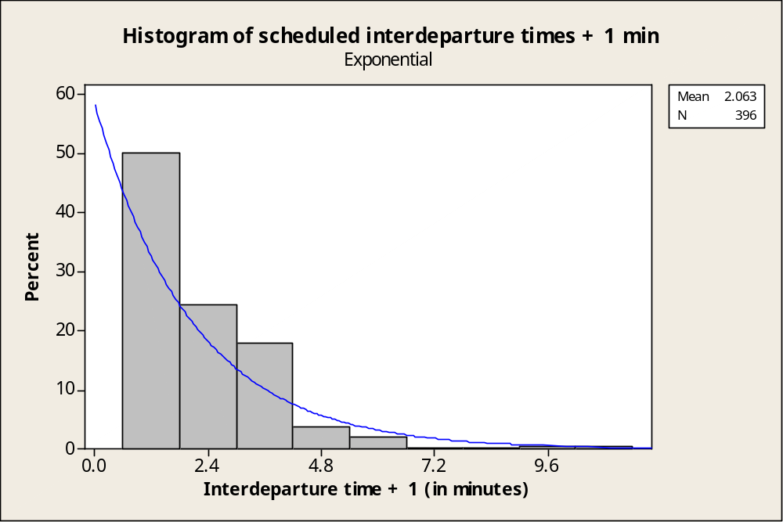
Scheduled departures : Distribution analysis
The inter-departure data might follow an exponential distribution

Slide 18
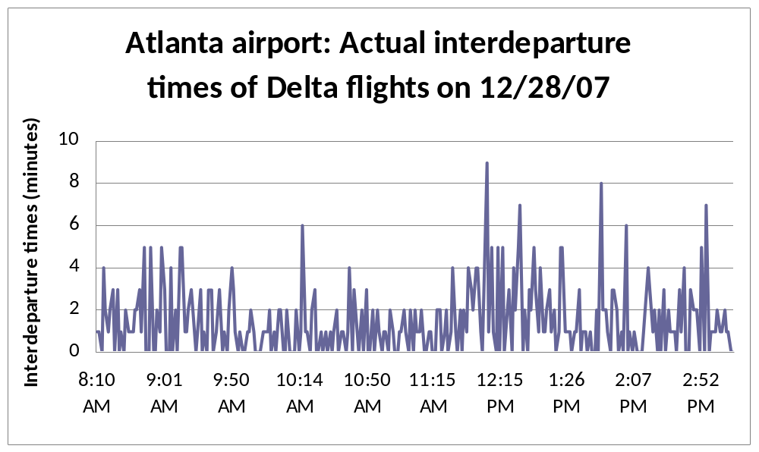
Data collection: Actual departures
A time series plot of the 285 actual inter-departure times reveals a possible change-point around 12 noon

Slide 19
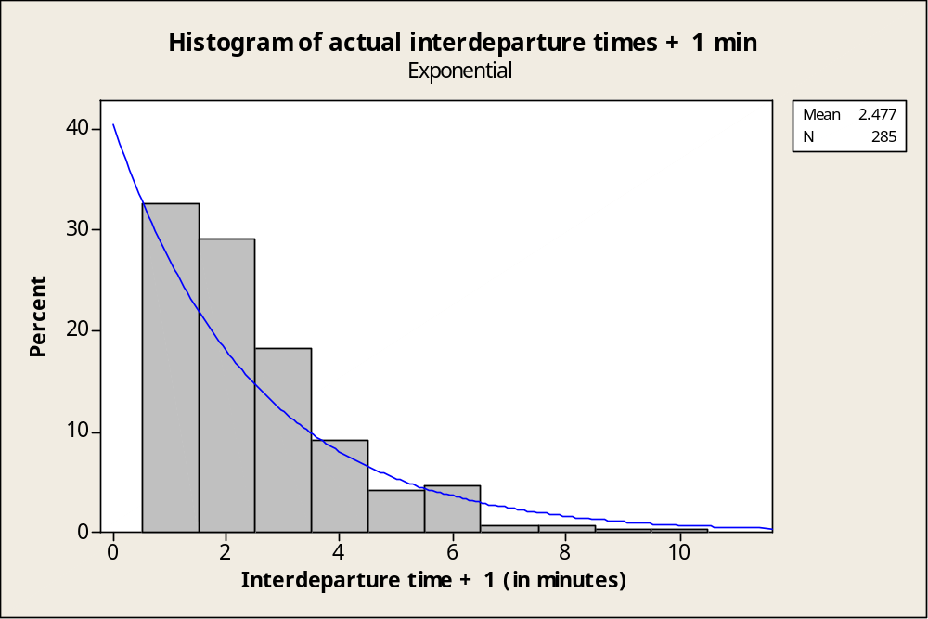
Actual departures : Distribution analysis
The inter-departure data did not fit an exponential distribution very well
However, a poor fit might be due to the presence of change-points

Slide 20
Exponential Distribution afterthoughts
Q: So, how is all that related to our Regression Analysis course?
A: Regression Analysis assumes a Normal distribution of the data. Knowing that some things naturally follow a distribution which is far from being normal, allows us to anticipate a violation of the normality assumption.
The problem can be fixed by applying a transformation of the data (more details later).

